Slide 1
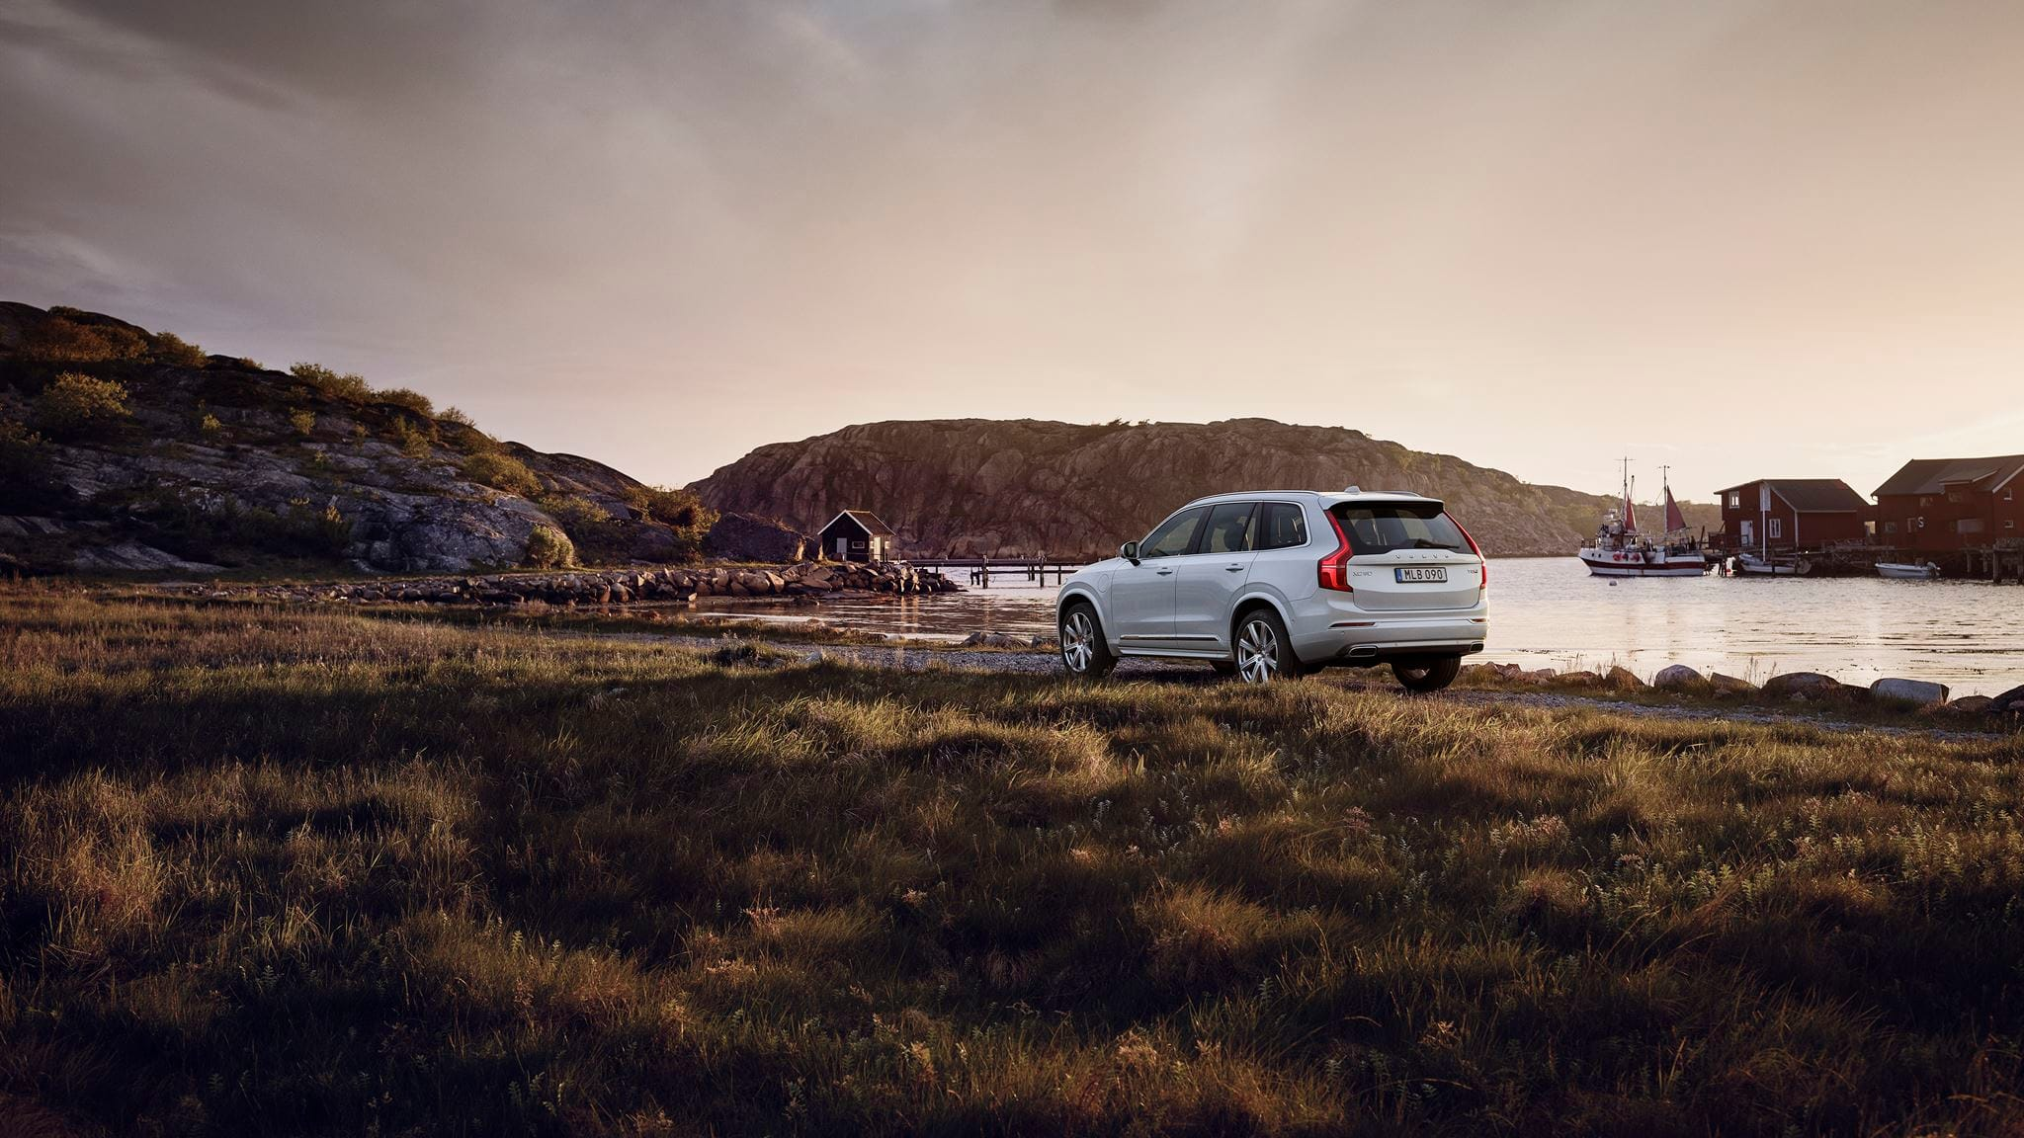

4Mobox
Business Project Proposal

Slide 2
Table of Content
Introduction
Product
Market Approach
Finance Proposal
Conclusion

Slide 3
Table of Content
Introduction
Product
Market Approach
Finance Proposal
Conclusion

Slide 4
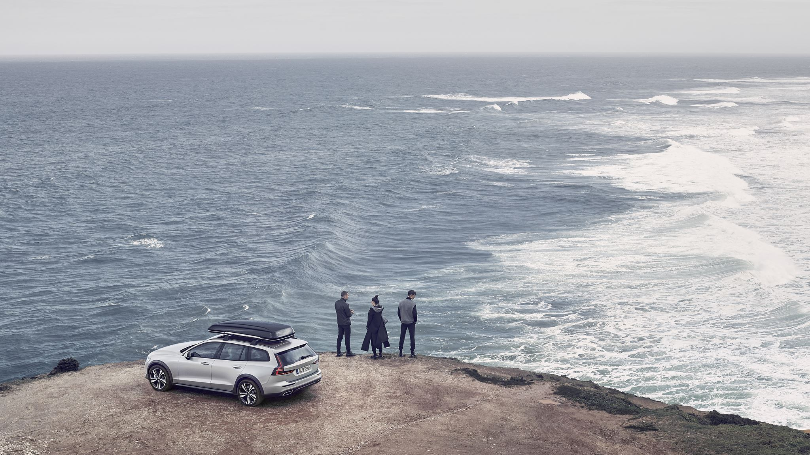

4 Mob = for mobility
Who we are

Slide 5
“
What we do
To link car with its data to help people fully exploit their data
”

Slide 6
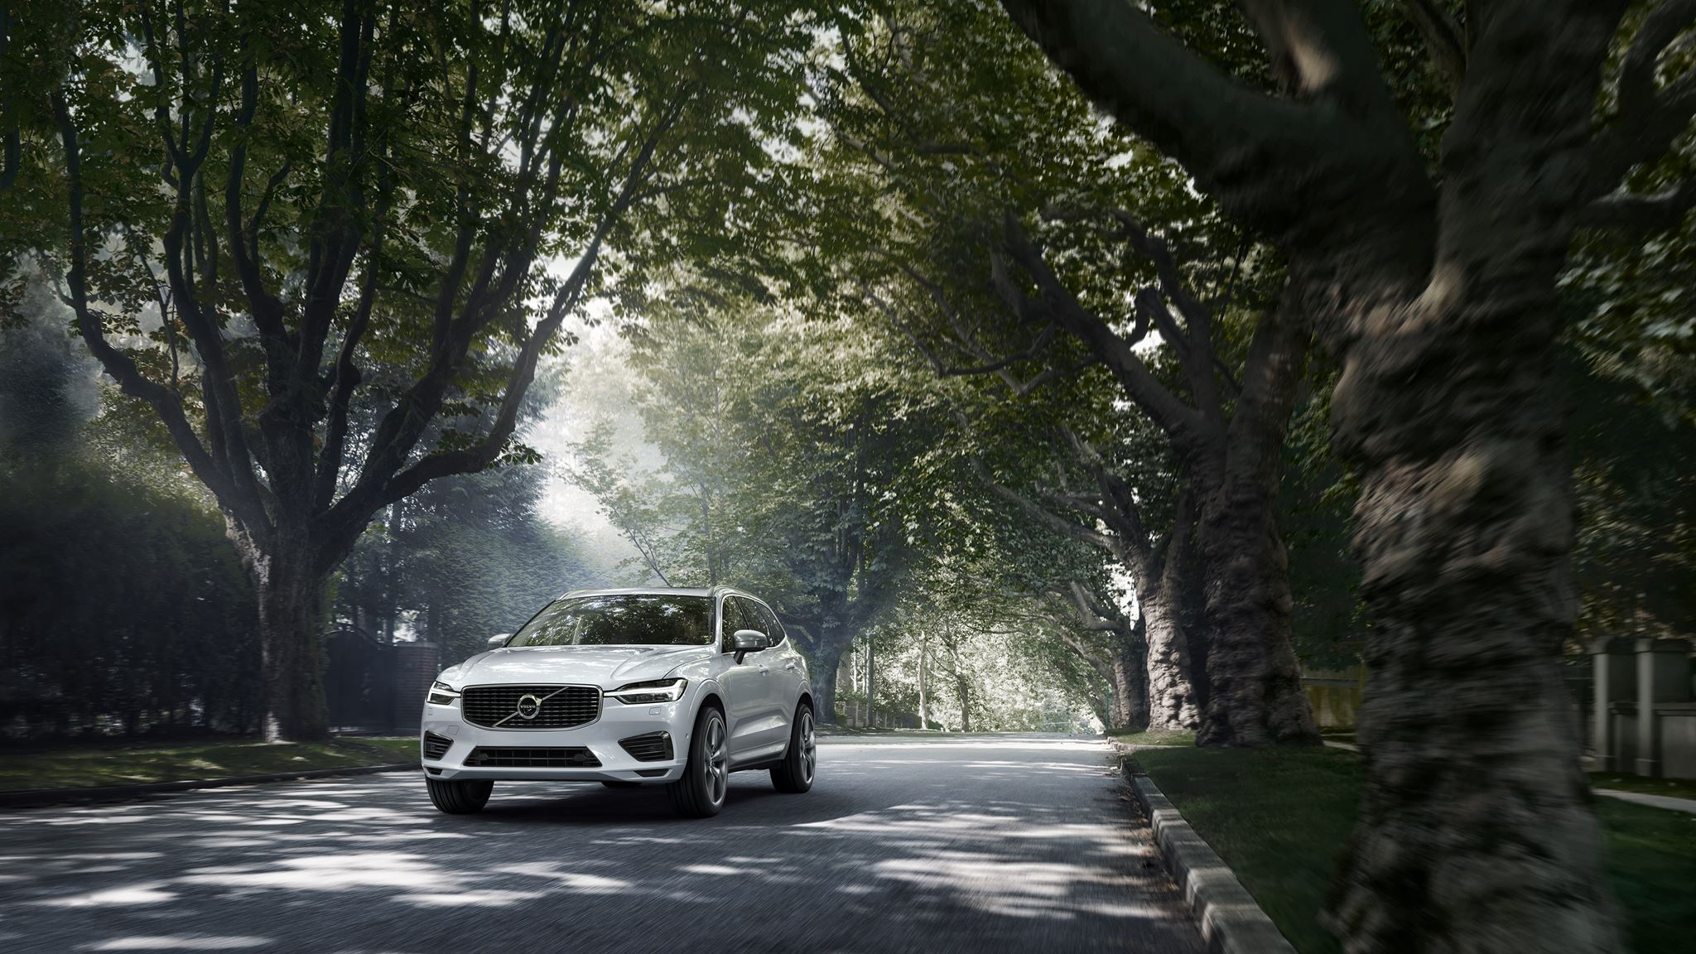
Table of Content
Introduction
Product
Market Approach
Finance Proposal
Conclusion

Slide 7
Problem
Drivers have no data
Young Drivers
Aging cars
Insurance companies
etc.

Slide 8
Problem
Solution
Drivers have no data
Young Drivers
Aging cars
Insurance companies
etc.
A device
An APP

Slide 9
Problem
Solution
Benefits
Drivers have no data
?
Young Drivers
Aging cars
Insurance companies
etc.
A device
An APP

Slide 10



Business Model
Data
OBD
Data
Device
APP
Data

Slide 11
Business Model
Data
OBD
Data
Device
APP
Data

Slide 12
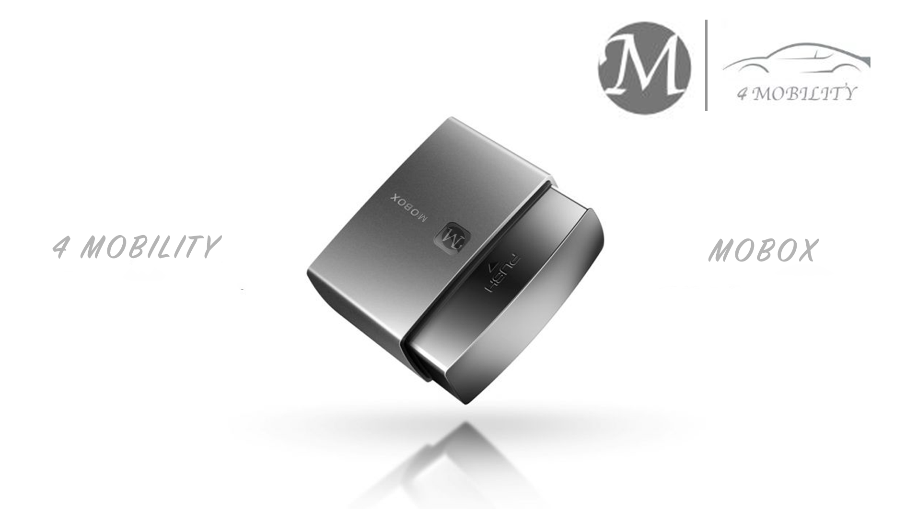
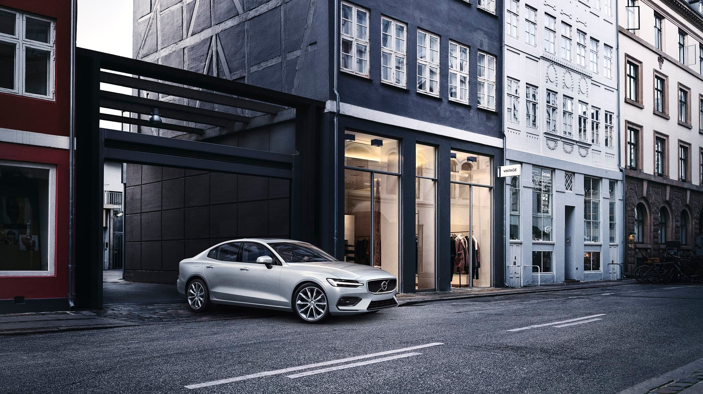
4Mobox

Slide 13
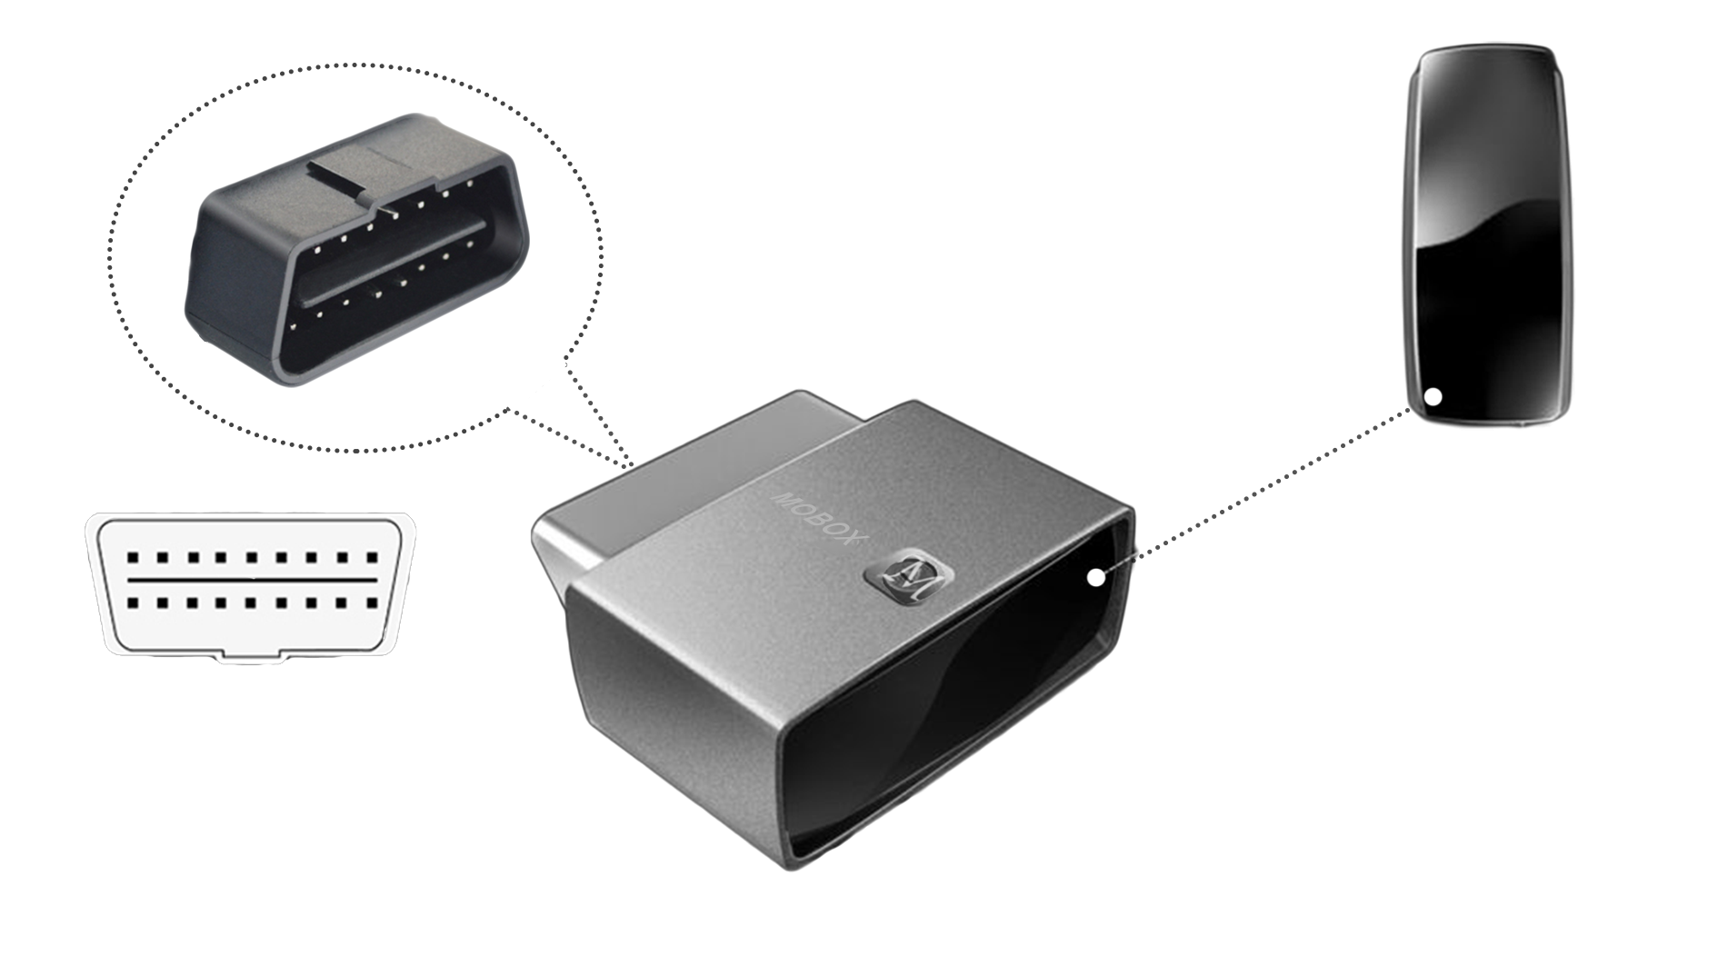
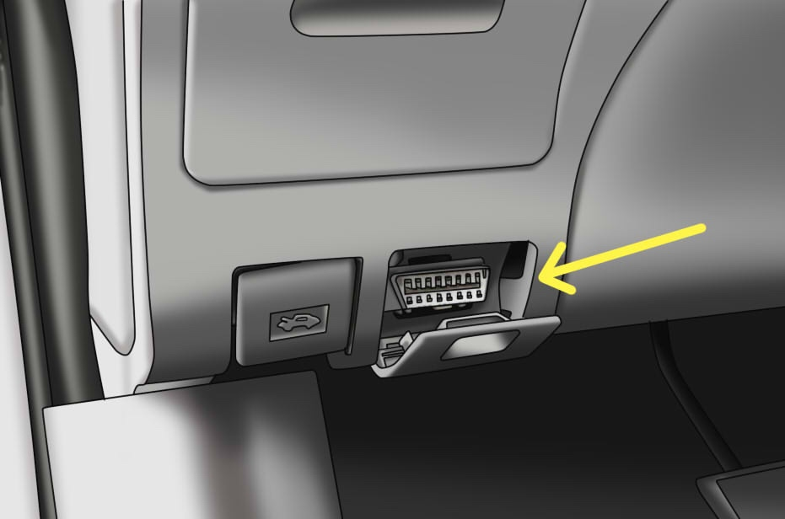

Slide 14
Business Model
Data
OBD
Data
Device
APP
Data

Slide 15
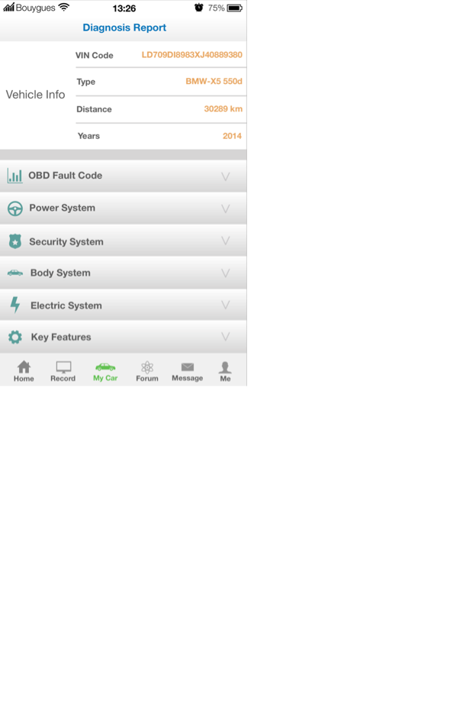
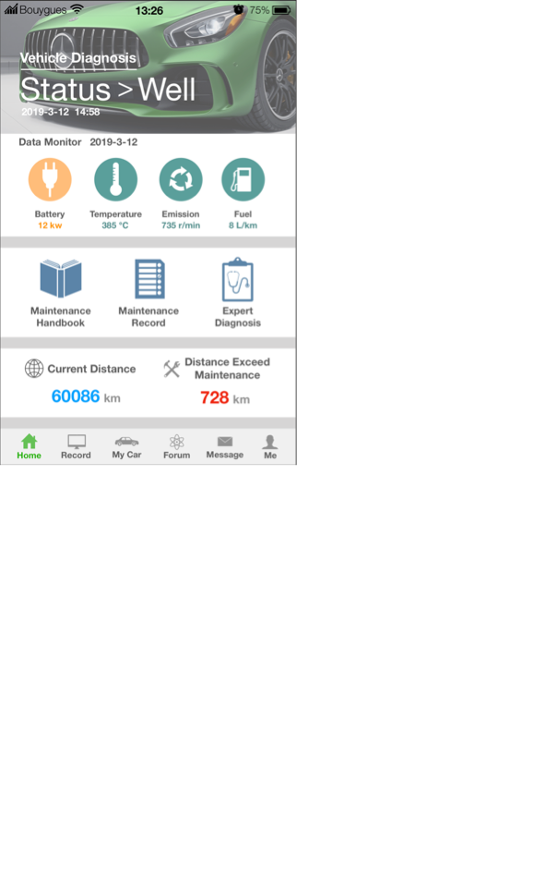
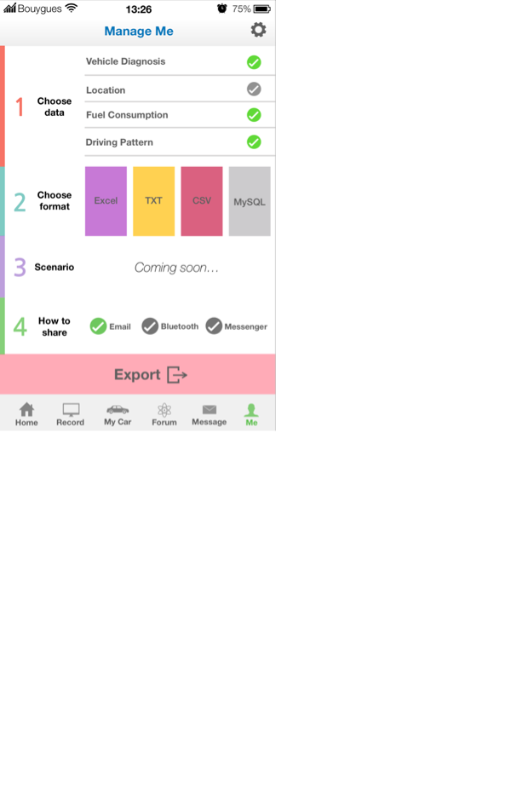
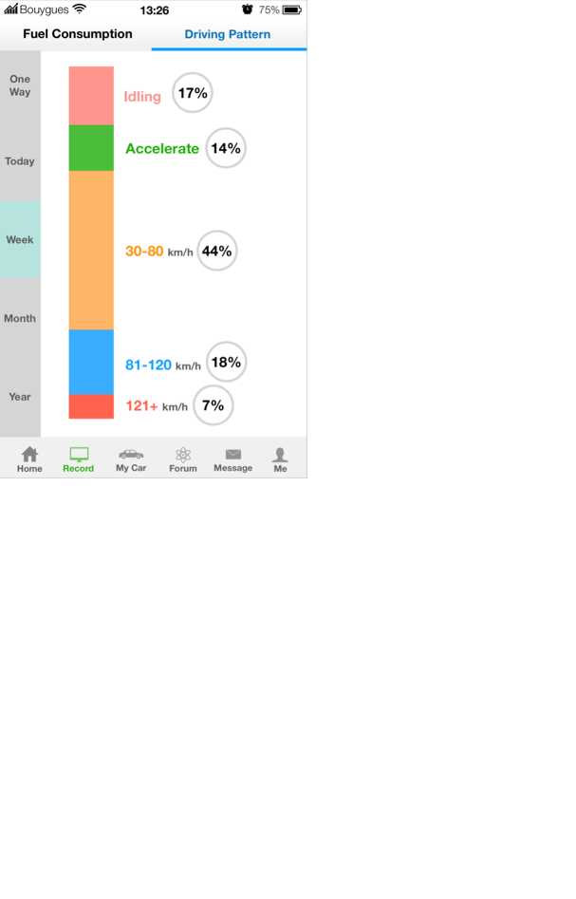
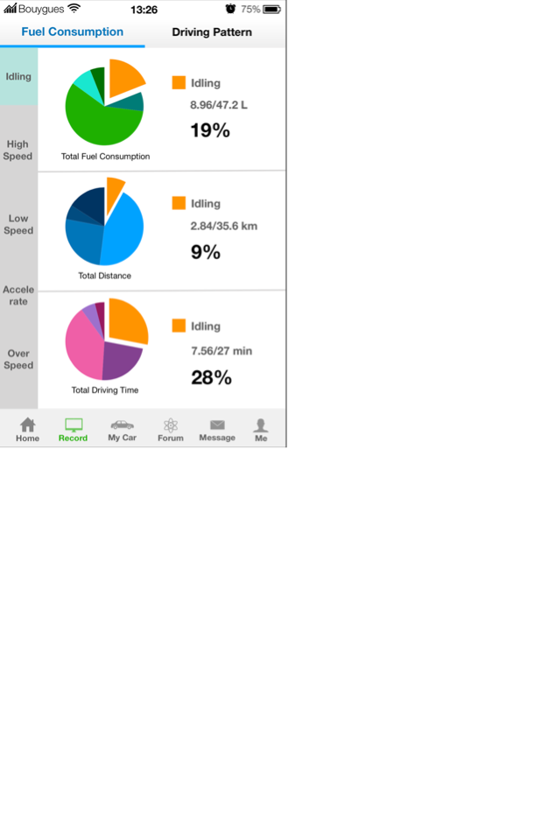
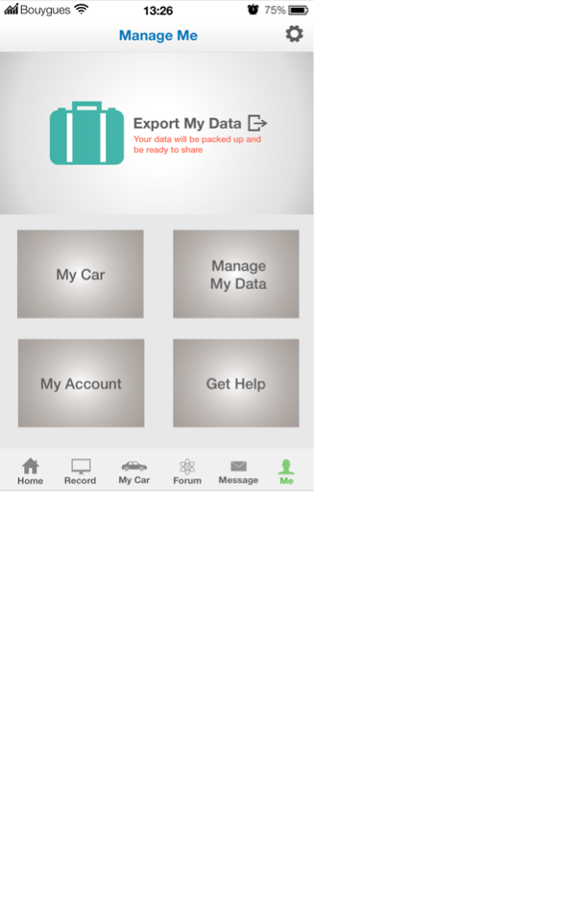

Slide 16
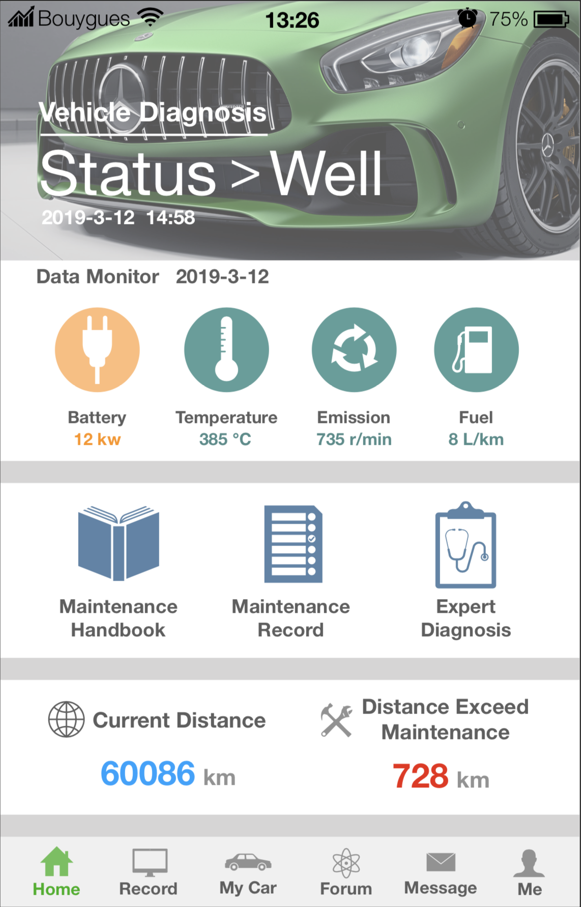
General Status
General Data Monitor
Home Page
Quick Access
Accumulative Data
Navigate Bar

Slide 17
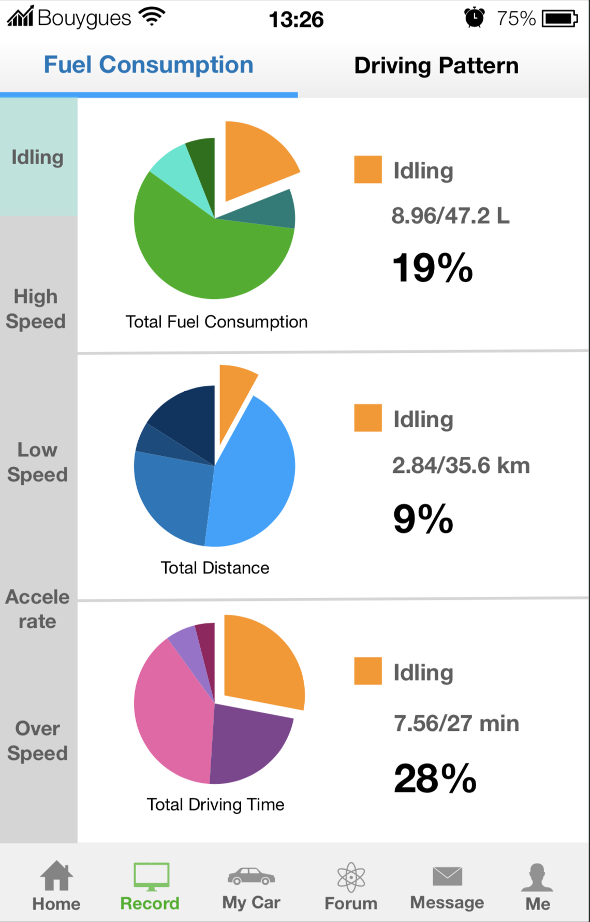
Record & Analysis

Slide 18
Record & Analysis

Slide 19
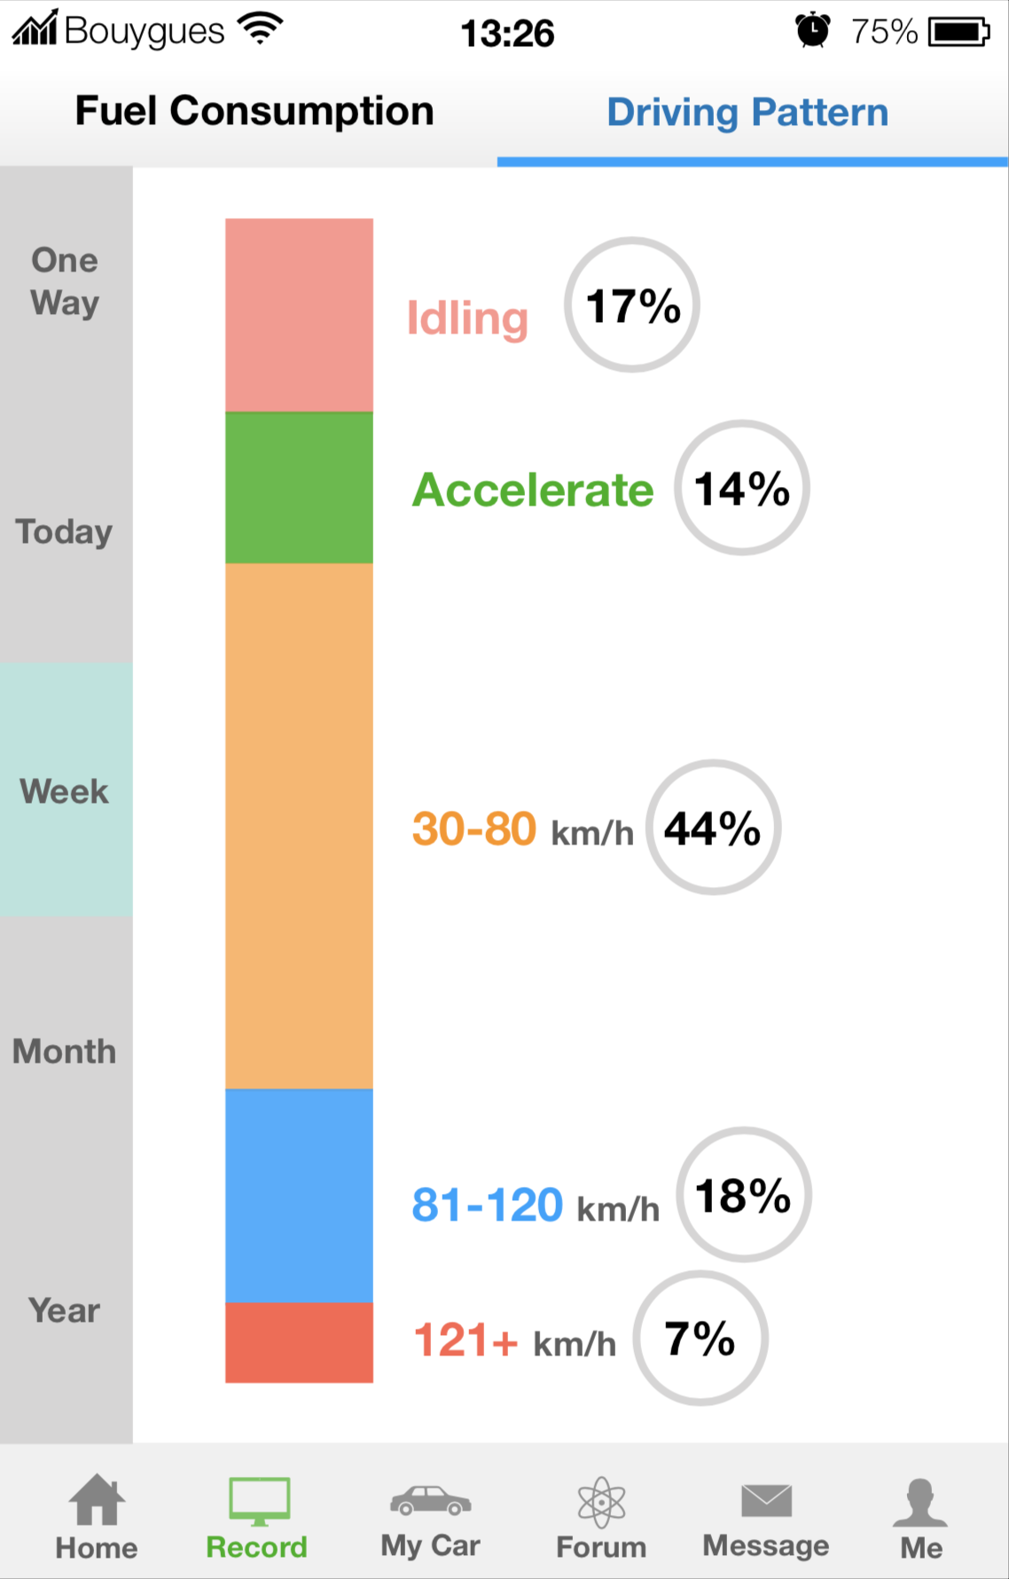
Record & Analysis

Slide 20
Record & Analysis

Slide 21
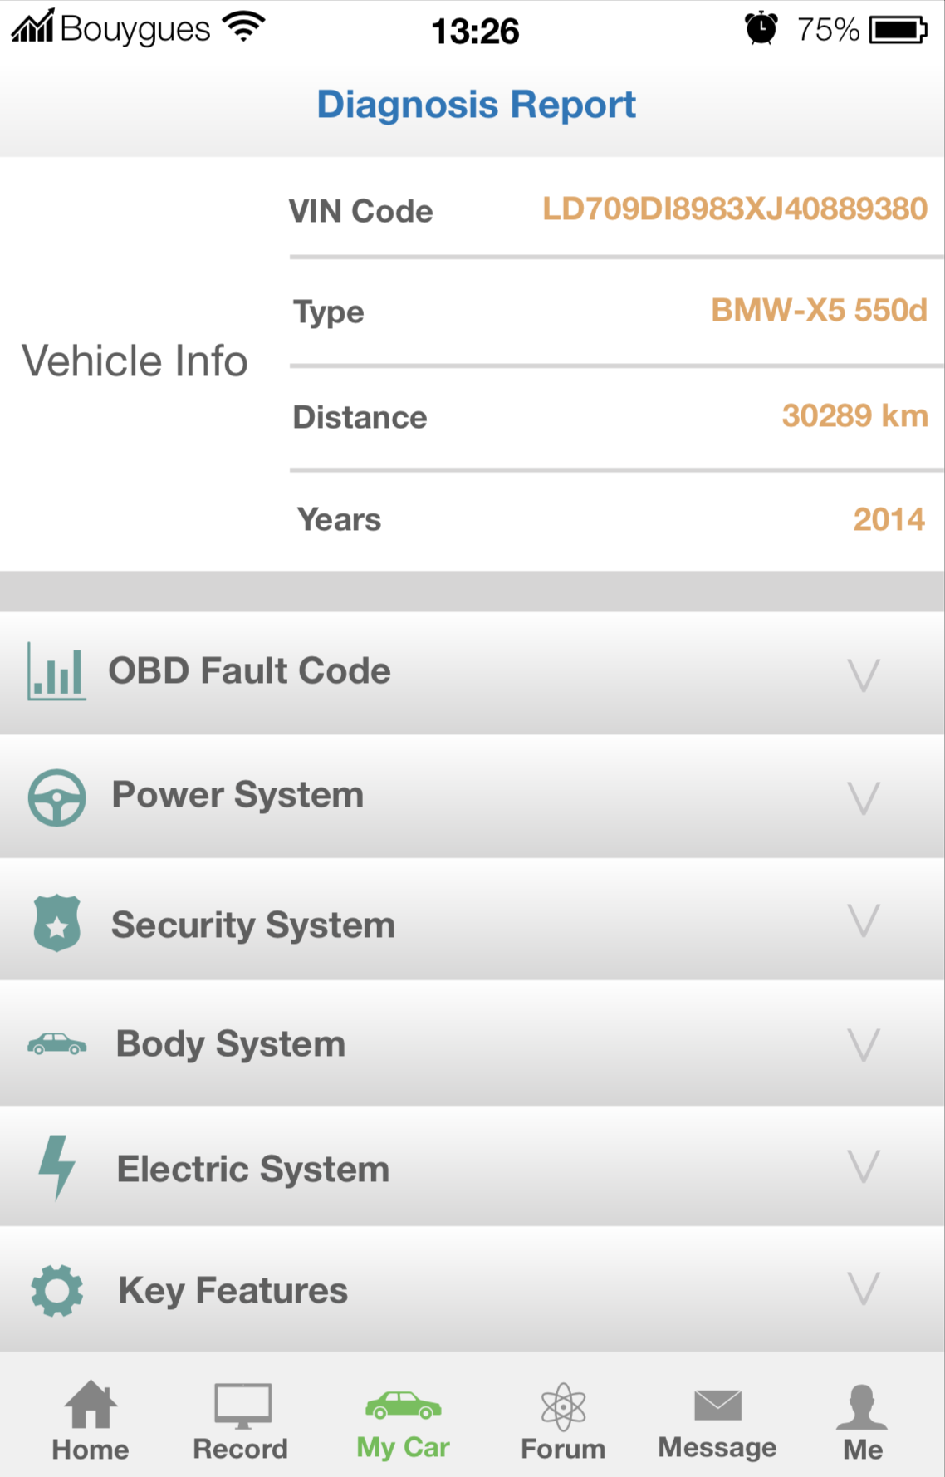
Diagnosis

Slide 22
Diagnosis

Slide 23
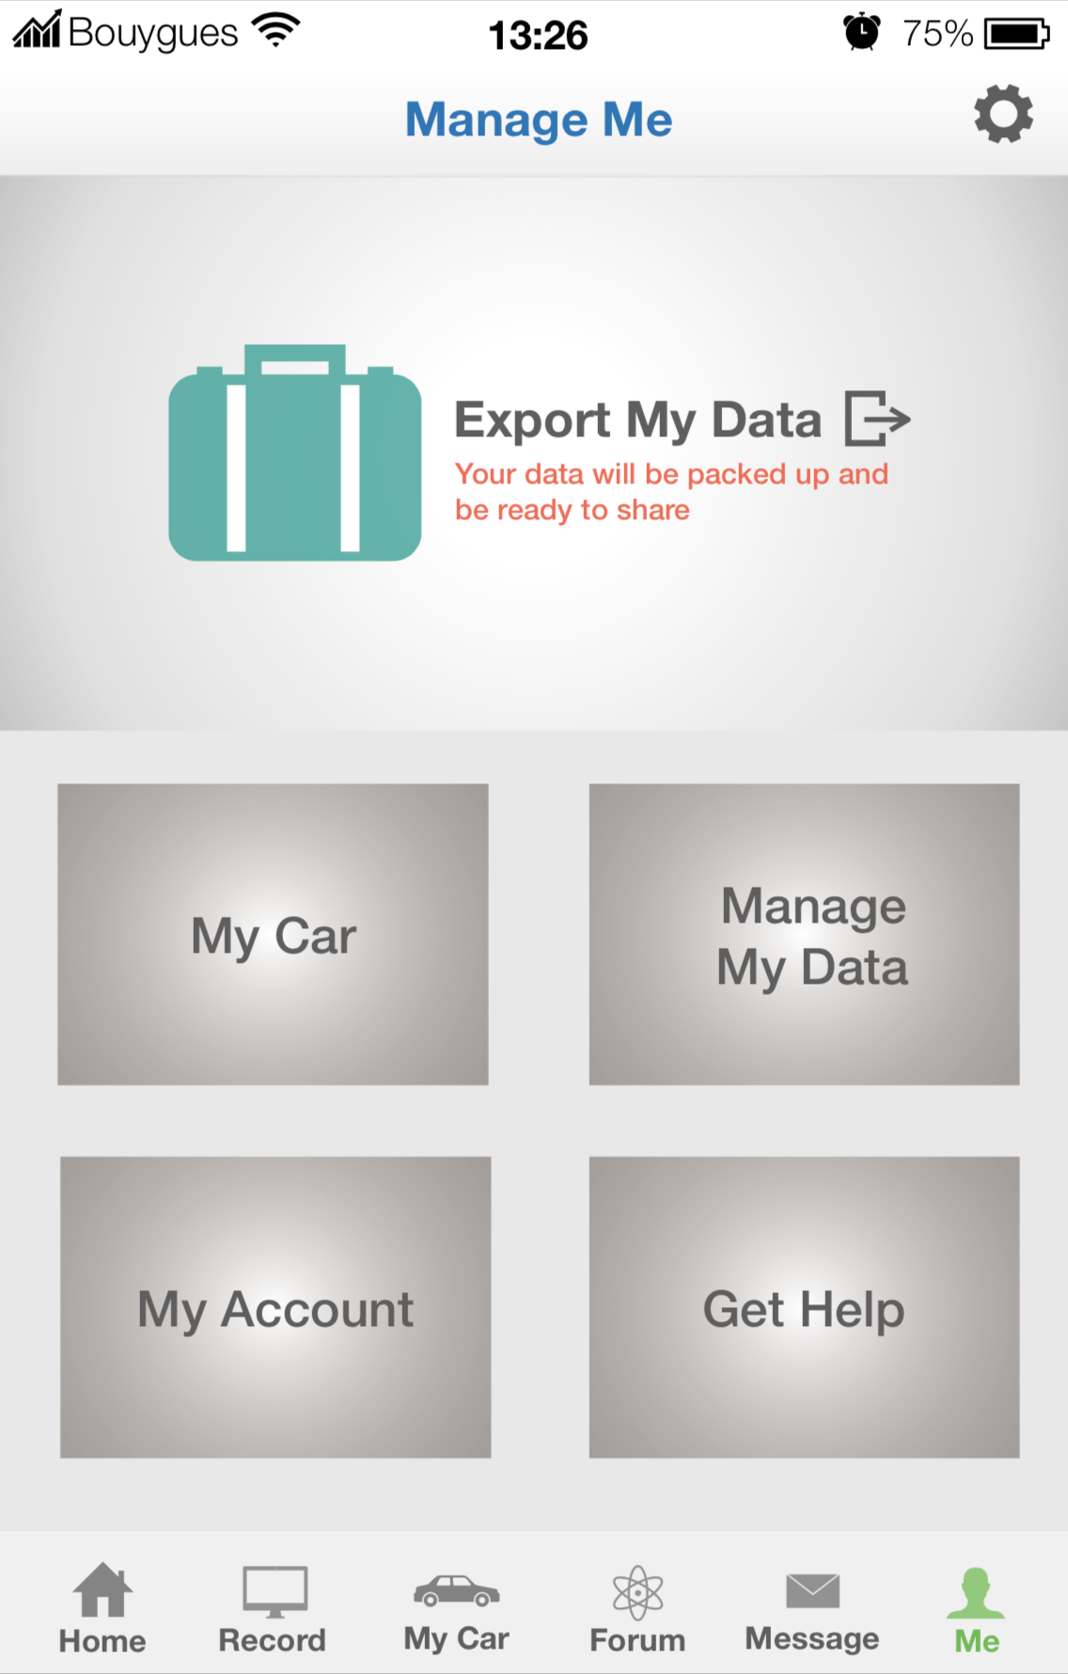
Diagnosis

Slide 24
Diagnosis

Slide 25
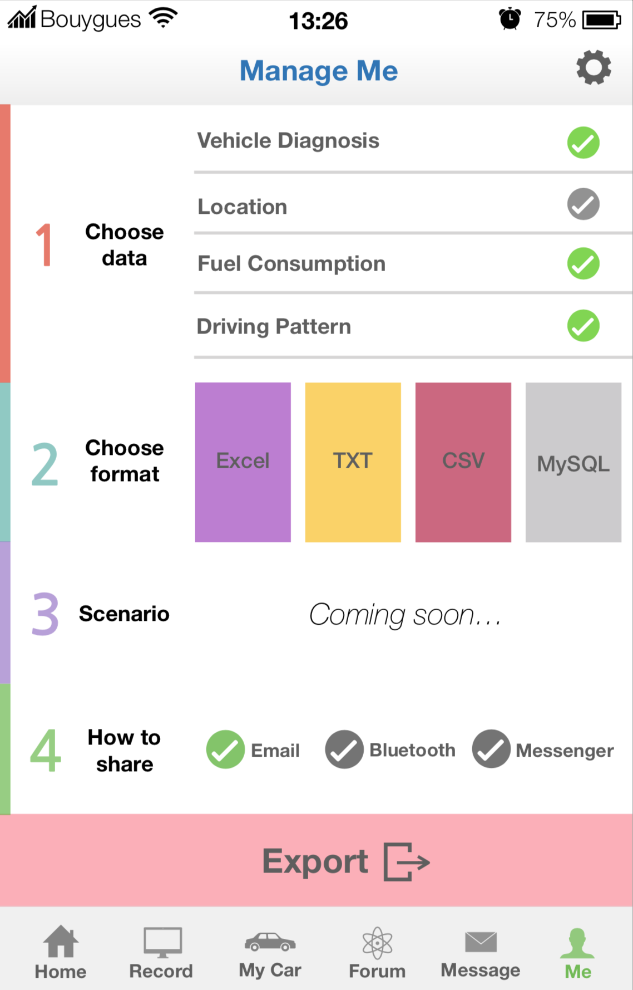
Data Management

Slide 26
Problem
Solution
Benefits
Drivers have no data
?
Young Drivers
Aging cars
Insurance companies
etc.
A device
An APP

Slide 27
Benefits
Problem
Solution
Insurance
Potential Size: 15bn
Willingness: 48%
Save: 5%-30%
Cost: 850 €
42.5 € - 255 €
Know your driving pattern
Change your driving pattern
Better fuel consumption
Instant diagnosis
Record of everything
A device
Drivers have no data
An APP
Secondhand car market
Car leasing market

Slide 28

Data
OBD
Data
Device
APP
Data
Sales on Devices
Supplementary Services

Slide 29
Table of Content
Introduction
Product
Market Approach
Finance Proposal
Conclusion

Slide 30
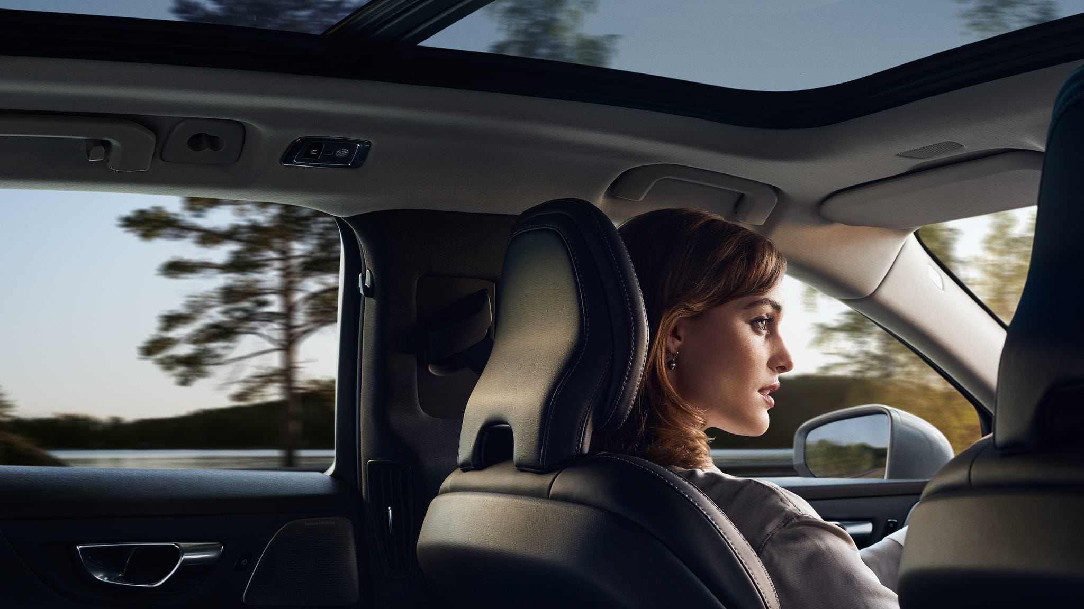
Private cars in France:
39,140,000
Cars produced after 2001(cars with in-built OBD):
32877600 (84%)
Cars doing regular inspections:
22027992 (67%)
Drivers who may be interested in:
2200000

Slide 31
Sales channels
Put on sale on Amazon, Fnac, Cdiscount, Darty
2. Our own website
Online
Physical stores fo Fnac, Cdiscount, Darty
automobile sale service shops, repair shops, car renting companies, gas stations
Offline

Slide 32

Target
Online
Offline
1. Build our own official website
2. Publish articles of introduction on mainstream online magazines of automobile
3. Using TrueView in-stream ads in Youtube, using keyword contextual targeting method.
1. Cooperation with Automobile Sales Service stores and garage(from city to city)
2. Cooperation with insurance companies
=> （UBI）Customers can enjoy certain discounts if they have good driving behavior
Raise the awareness of our product Mobox; Increase product coverage for online and offline channels
Period 1
Period 2

Slide 33
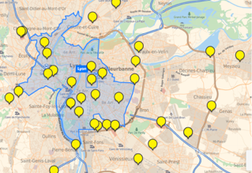
Target
Online
Offline
1. Build our own official website
2. Publish articles of introduction on mainstream online magazines of automobile
3. Using TrueView in-stream ads in Youtube, using keyword contextual targeting method.
1. Cooperation with Automobile Sales Service stores and garage(from city to city)
Raise the awareness of our product Mobox; Increase product coverage for online and offline channels
Period 1
Period 2

Slide 34
Target
Online
Offline
1. Build our own official website
2. Publish articles of introduction on mainstream online magazines of automobile
3. Using TrueView in-stream ads in Youtube, using keyword contextual targeting method.
1. Cooperation with Automobile Sales Service stores and garage(from city to city)
2. Cooperation with insurance companies
=> （UBI）Customers can enjoy certain discounts if they have good driving behavior
Raise the awareness of our product Mobox; Increase product coverage for online and offline channels
Period 1
Period 2

Slide 35
Private cars in France:
39,140,000
Cars produced after 2001(cars with in-built OBD):
32877600 (84%)
Cars doing regular inspections:
22027992 (67%)
Drivers who may be interested in:
2200000

Slide 36
Target
Online
Offline
Period 1
1. Using Google ads to realize search engine optimization. When users search “OBD”, “OBD Box”, “Mobox”, the priority goes to our official website.
2. Invite evaluation automobile media
3. Advertising on second-hand car trading websites
4. Gather users experience reports
5. Vouchers return to customers who give us 5 stars on online distribution channels
Increase users’ using of the OBD system and Mobox
Continue the first period. Cooperation with second hand cars trading physical stores, insurance companies, gas stations
Period 2

Slide 37
Mature period
Target:
- Increase ads volume
- Maximizing advertising revenue
- Optimizing searching results
- Searching engine version rate
Promotion:
SEO
2. Cooperate with influencers and KOLs in the automobile industry
3. Higher cost ads (Using famous commentators, etc)

Slide 38

Table of Content
Introduction
Product
Market Approach
Finance Proposal
Time Line

Slide 39
Cost Analysis
With early stages projections we can expect a cost per unit produced ranging from 28€ to 53€. The cost size decreases with larger volumes produced.
First suppliers contacted offer a production price ranging from 30€ to 60€ (not including software development).
(Potential suppliers contacted: Shanghai Star Electronic Technology Co., Ltd; Shenzhen Mingching Electronics Technology Co., Ltd.; Dongguan Andu Electronic Co., Ltd. ; Shenzhen Aovlex-link Technology Co., Ltd. )

Slide 40
Market Price Analysis
2. Market prices range from 40€ to 160€, with 102,77€ being an average price of a large sample we studied.
3. Nevertheless, most of these products are presented as gadgets for punctual usage and not as a service with great value.
1. Competitors/Substitutes prices
Products | Services | Price
Automatic | Collision Detection using acceleration data; Bluetooth connectivity | 129,95 €
CarLock | Export of trips to Excel; Alerts on car's health, maintenance | 99,95 €
Verizon Hum | Automatic crash detection and roadside assistance, Mechanics Hotline | 49,99 €
Vyncs Link | Trip history, driving score; 3G wireless connection | 74,98 €
Fleet Genius | Maintenance management software for vehicle fleet | 159,00 €
 | Range (40€-160€) Average price: | 102,77 €

Slide 41
1. Results from own research
on psychological price:
50€ ~ 80€
2. Dynamic pricing strategy
Device: 39.99 €
How much are people willing to pay?
2.99€/month
4.99€/month
5.99€/month
Pack Discovery
Pack Explorer
Pack Conqueror

Slide 42
Financial projection of P&L (3 first years)

Slide 43
Financial projection of P&L (3 first years)

Slide 44
Financial projection of P&L (3 first years)

Slide 45
Financial projection of P&L (3 first years)

Slide 46
Table of Content
Introduction
Product
Market Approach
Finance Proposal
Time Line

Slide 47






Time line
Market
Research
Capital
Raising
Product
Develop
Manufac-
turing
Marketing
Advertising
2 mths
3 mths
7 mths
3 mths
3 mths

Slide 48

4Mobox
4Mobox
Thank you!
Thank you!

Slide 49
Financial projection of P&L (3 first years)
REVENUES | YEAR 1 | YEAR 2 | YEAR 3
Number of sales | 1300 | 2500 | 4300
Mobox: Pack Discovery | 34,252.40 € | 65,870.00 € | 113,296.40 €
Mobox: Pack | 46,732.40 € | 89,870.00 € | 154,576.40 €
Mobox: Pack Conqueror | 26,486.20 € | 50,935.00 € | 87,608.20 €
TOTAL REVENUES | 107,471.00 € | 206,675.00 € | 355,481.00 €
Cost of goods | 39,000.00 € | 75,000.00 € | 129,000.00 €
NET REVENUE | 68,471.00 € | 131,675.00 € | 226,481.00 €
COSTS
Storage unit/ warehouse costs |  | 6,000.00 € | 6,000.00 €
Advertising and Promotion | 7,500.00 € | 5,000.00 € | 7,500.00 €
Website - App maintenance - DB Storage | 5,000.00 € | 6,000.00 € | 10,000.00 €
App developement | 20,000.00 € | 3,000.00 € | 4,000.00 €
Transportation cost | 1,400.00 € | 2,100.00 € | 2,800.00 €
Utilities (for company workers) | 15,000.00 € | 10,200.00 € | 10,200.00 €
Overhead costs (Accounting/ Marketing/ Wages) | 68,400.00 € | 68,400.00 € | 90,000.00 €
Bank Loan | 12,620.04 € | 12,620.04 € | 12,620.04 €
 | 36,000.00 € | 36,000.00 € | 42,000.00 €
TOTAL OPERATING EXPENSES | 165,920.04 € | 149,320.04 € | 185,120.04 €
NET INCOME (LOSS) | -97,449.04 € | -17,645.04 € | 41,360.96 €

Slide 50
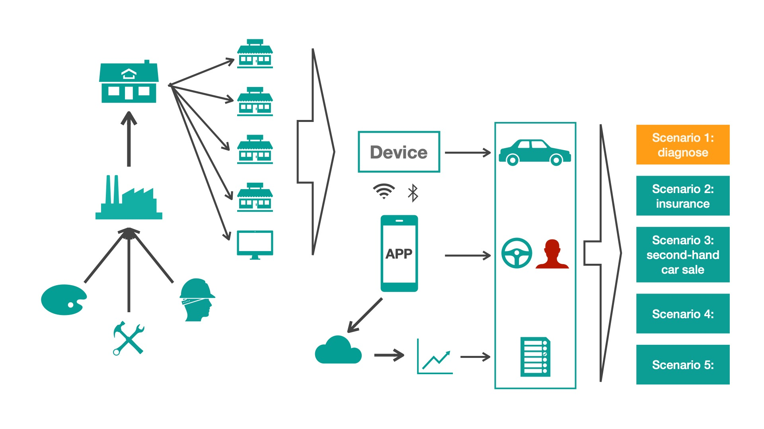

Slide 56
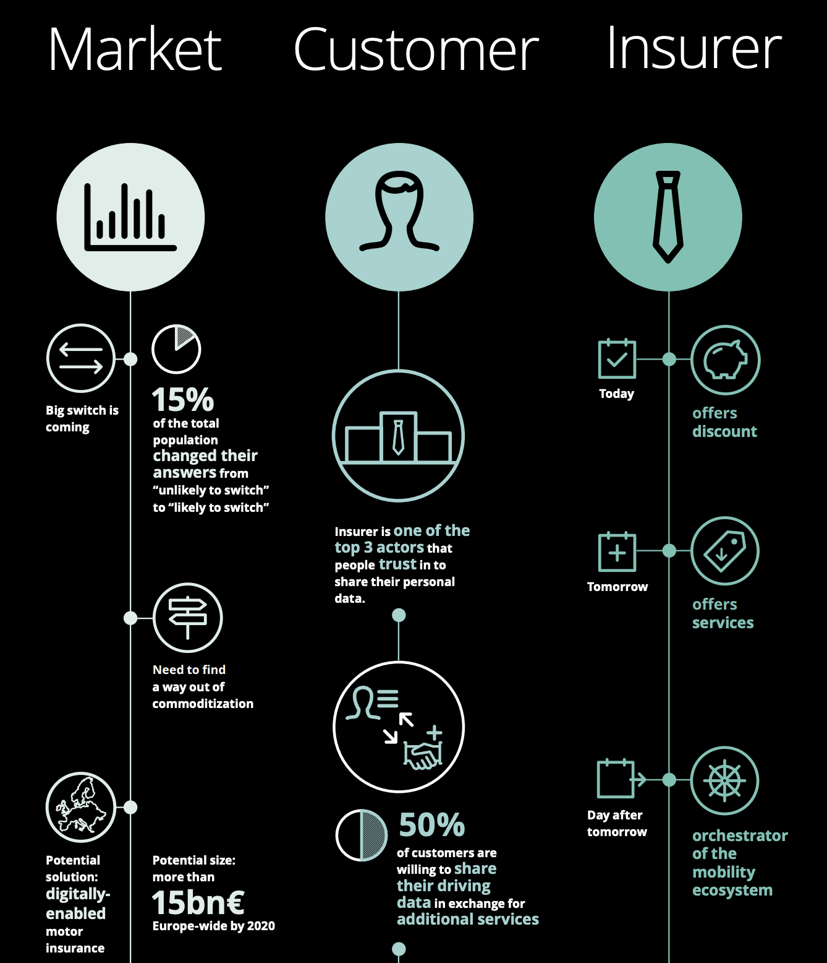
form Deloitte:

Slide 57
KPMG:
And with good reason, as autonomous cars could lead to a 93% reduction in accidents by 2040, with the price of insurance contracts possibly falling accordingly.
AXA:
David Zuby, Vice-President of the Insurance Institute for Highway Safety is already reporting that "vehicles with collision-avoidance systems have an accident rate which is 7-15% lower than that of other vehicles".
https://www.french-property.com/news/money_france/cost_car_insurance/

